Slide 1
Insights Into Patient Mortality
Using Deep Learning Models and MIMIC III
Jef DeWitt | March 28, 2025

Slide 2
Motivation
This study uses patient data to investigate deep learning’s role in predicting in-hospital mortality.
MIMIC-III is a dataset of patient information from critical care units at a large hospital. The research presented here uses Python-based libraries, such as Scikit-learn and PyTorch, for predictive analytics. Early prediction enables better interventions.
Traditional clinical systems often rely on numerical lab results and vital signs, overlooking the patterns hidden in clinician notes. Natural language processing tools and deep-learning models open up the wealth of unstructured data available in medical records.

Slide 3
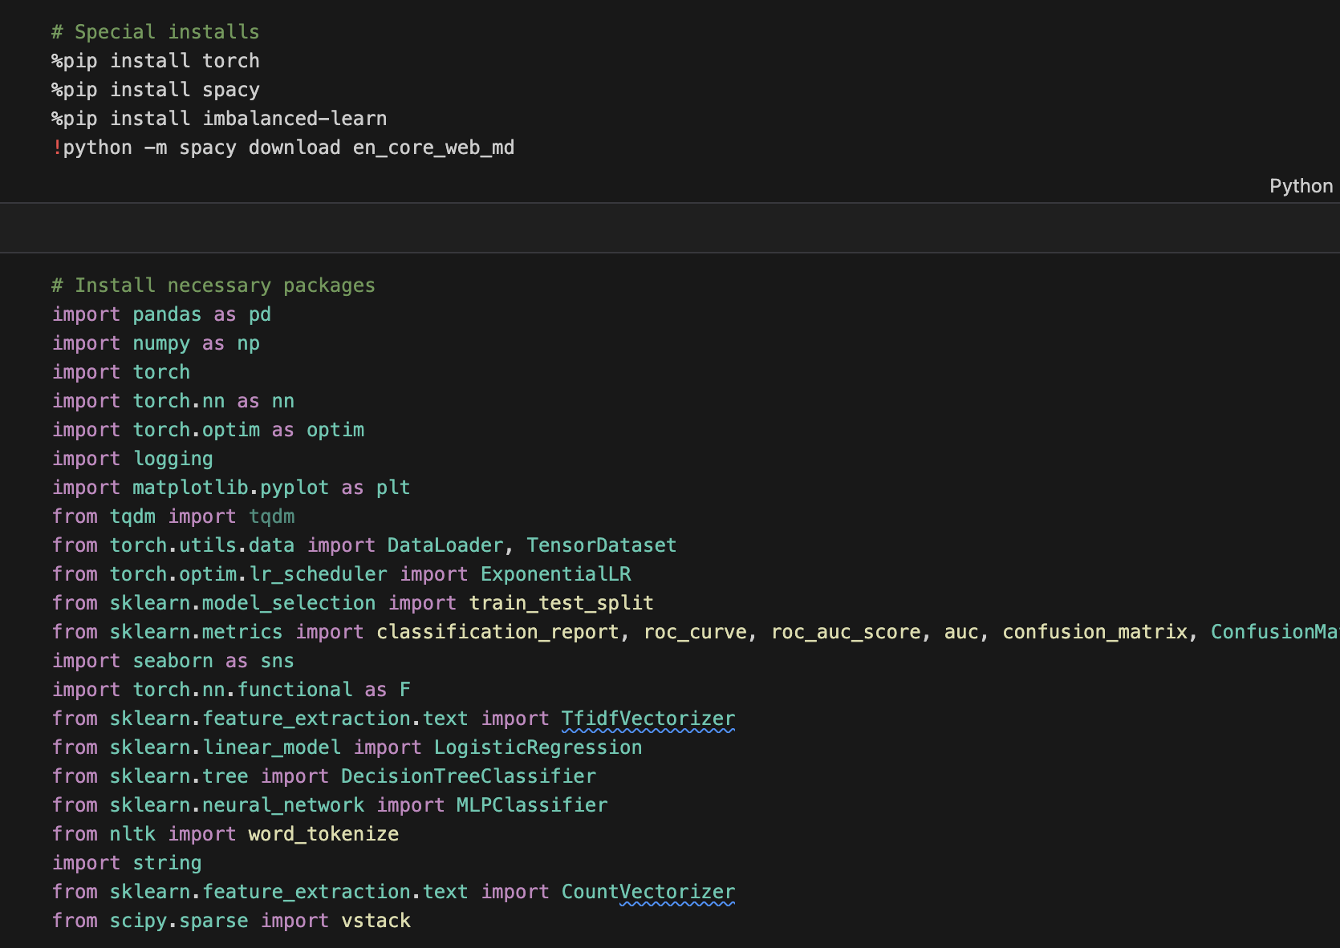
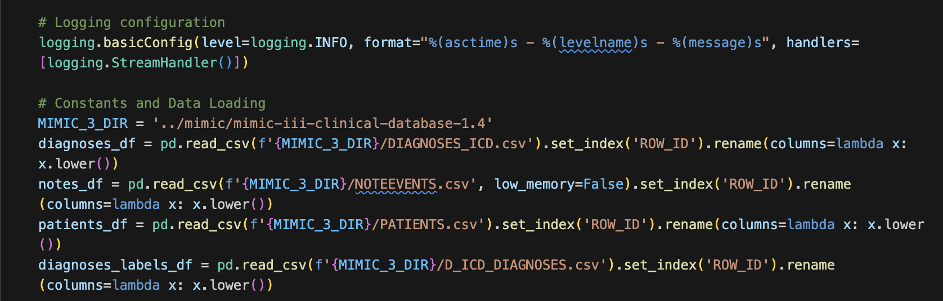
Imports
Libraries & MIMIC III Tables
Necessary Python libraries were imported.
Datasets were loaded using Pandas, reading patient demographics, diagnosis data, and clinical notes into respective dataframes.
Column casing was formatted.

Slide 4
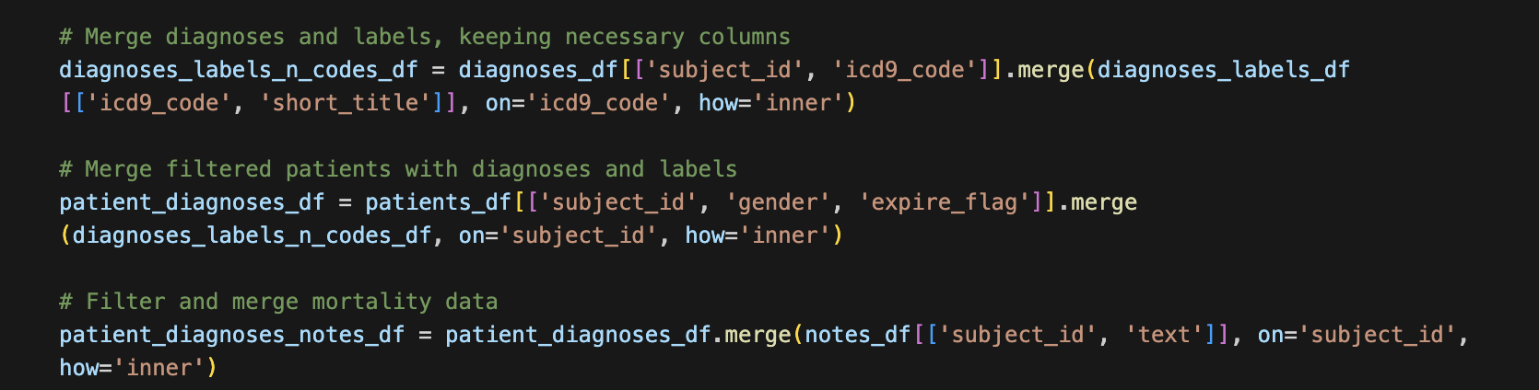
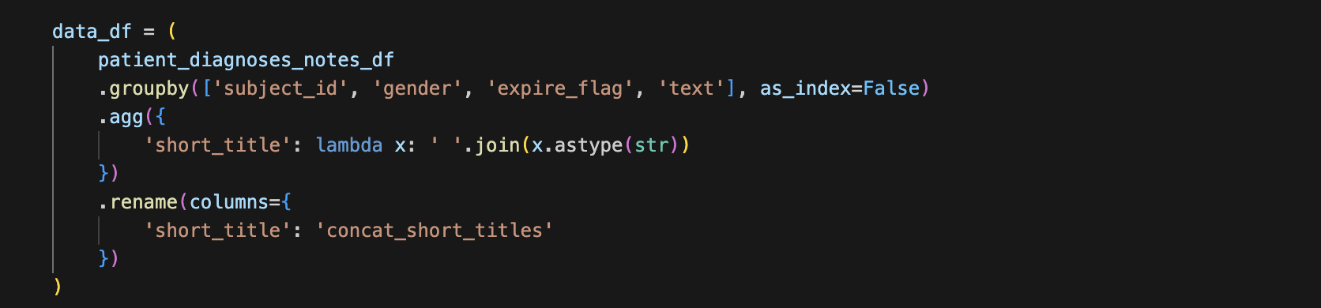
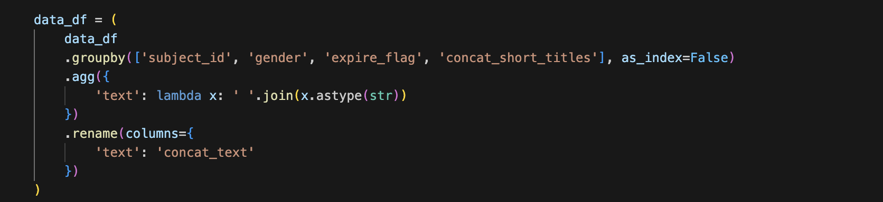
Feature Engineering
Preparing the Data
Dataframes were combined, keeping only the most useful features.
This reduces complexity and allows for greater targeting of high-signal features.
Patients with multiple rows of data were aggregated.
Text in the form of diagnostic and discharge notes were combined.
These features form the core input to the mortality prediction model.

Slide 5
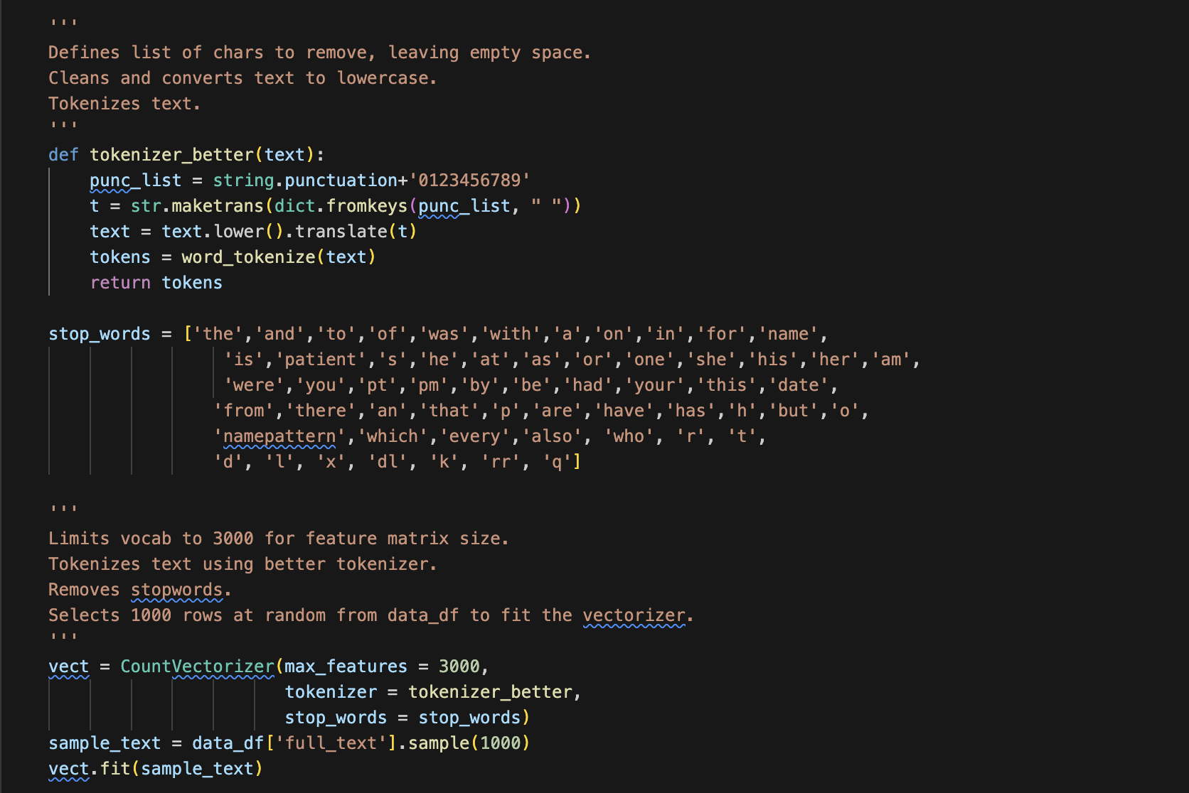
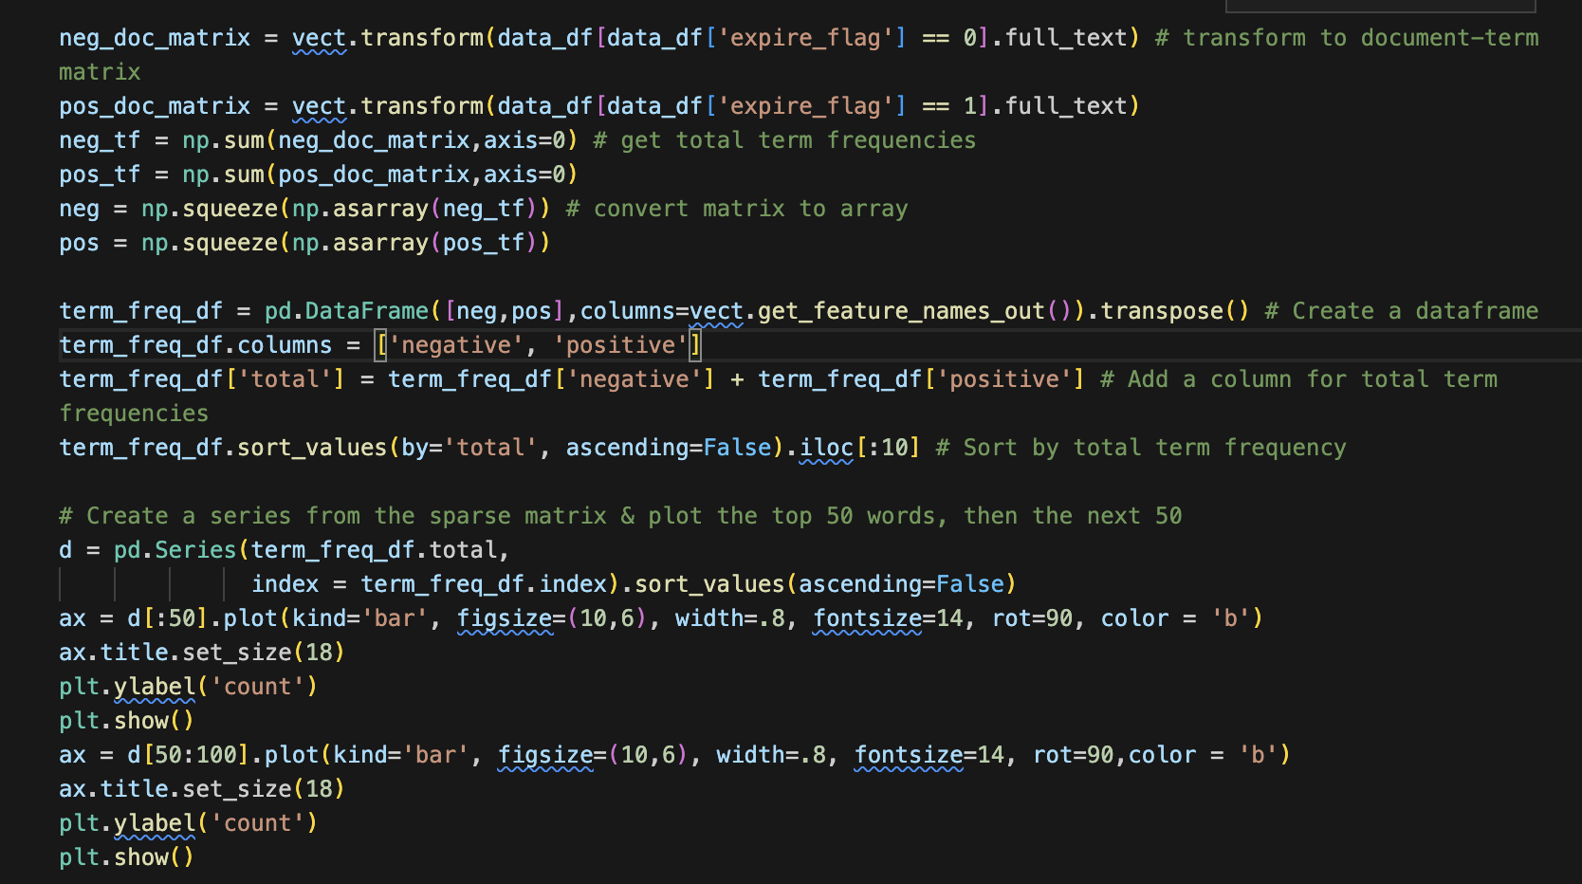
Tokenization
Converting Plain Text
A custom tokenizer was created to glean valuable words from the raw text input.
A list of excluded words reduces low-impact terms from tokenization.
Due to the sample size, only 1000 rows were selected for charting (next slide).
Text corresponding to expire_flag values (0 or 1) were converted to matrices for word importance charting shown later.

Slide 6
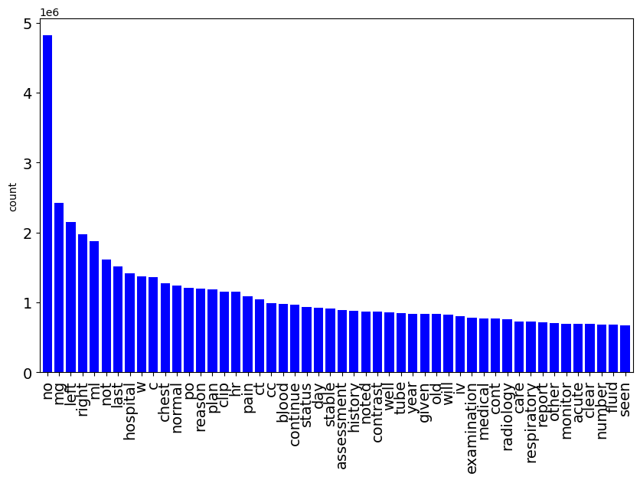
Common Words
Found in Medical Texts
These words are derived from diagnoses and discharge notes.
The most common words are shown by frequency of occurrence.
Frequent terms included administrative language ('discharge', 'hospital') and diagnosis categories ('acute', ‘stable’, and ‘status’).
Notably, terms like ‘acute' and ‘stable’ may aid in predicting a patient’s likely mortality.

Slide 7
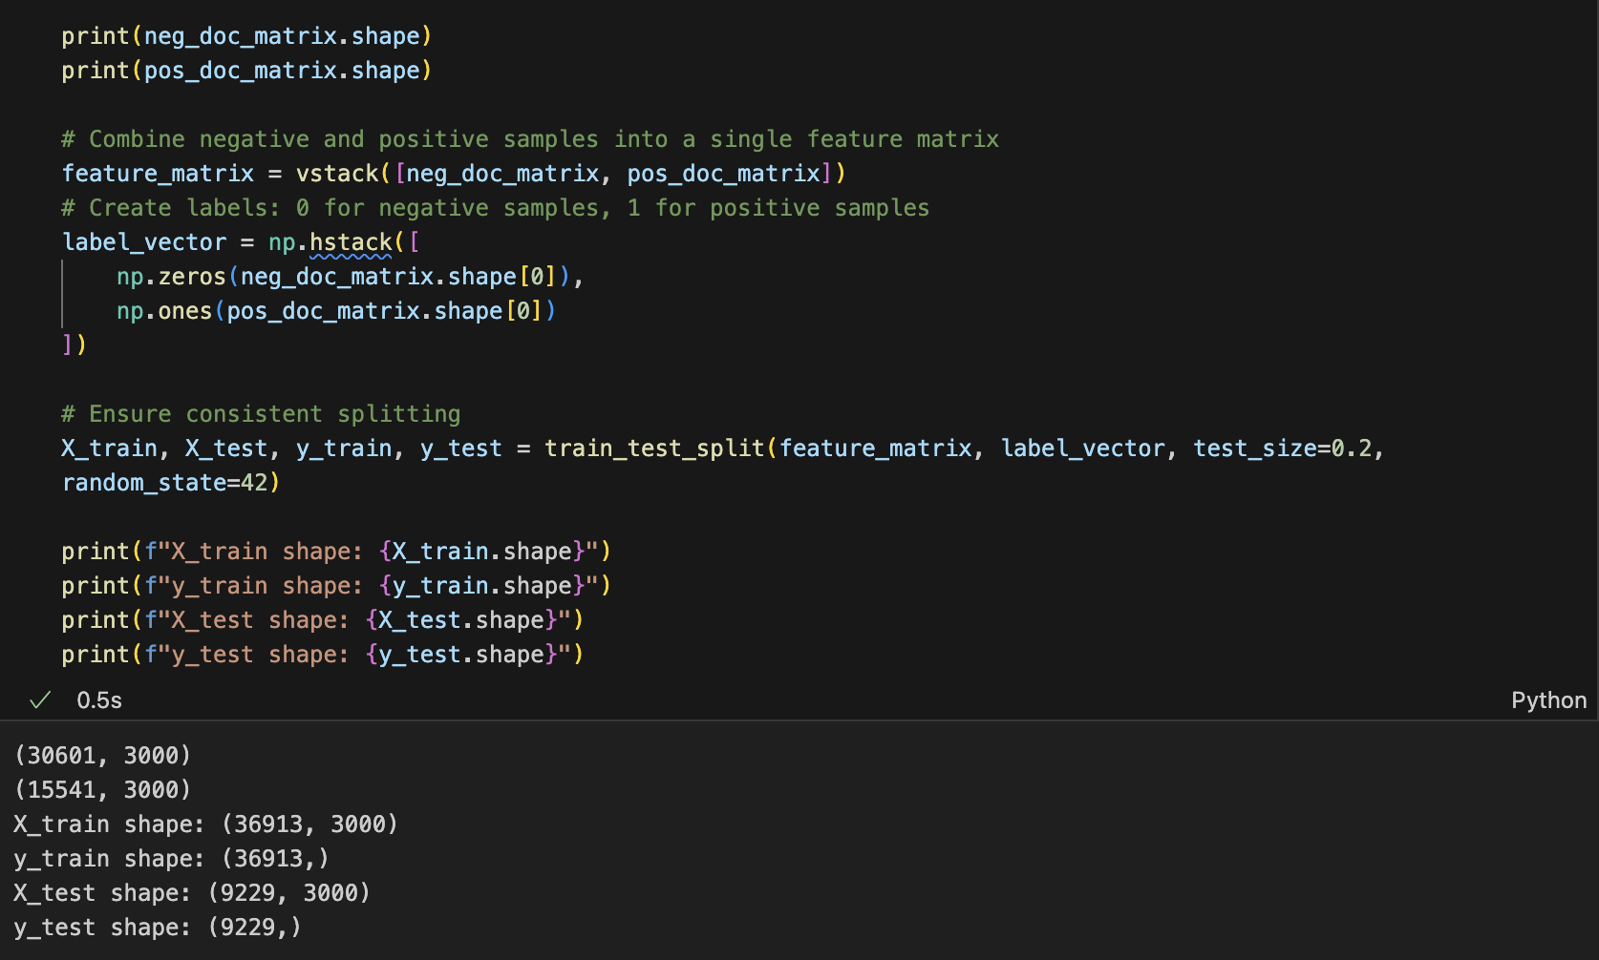
Shapes Check
Deep Learning & Vectors
Data is converted into vector and matrix formats.
The shapes of these data were validated to match input requirements for deep learning models.
The previously matricized ‘expire_flag’ data is divided into training and test sets for logistic regression modeling (shown in the next slide).

Slide 8
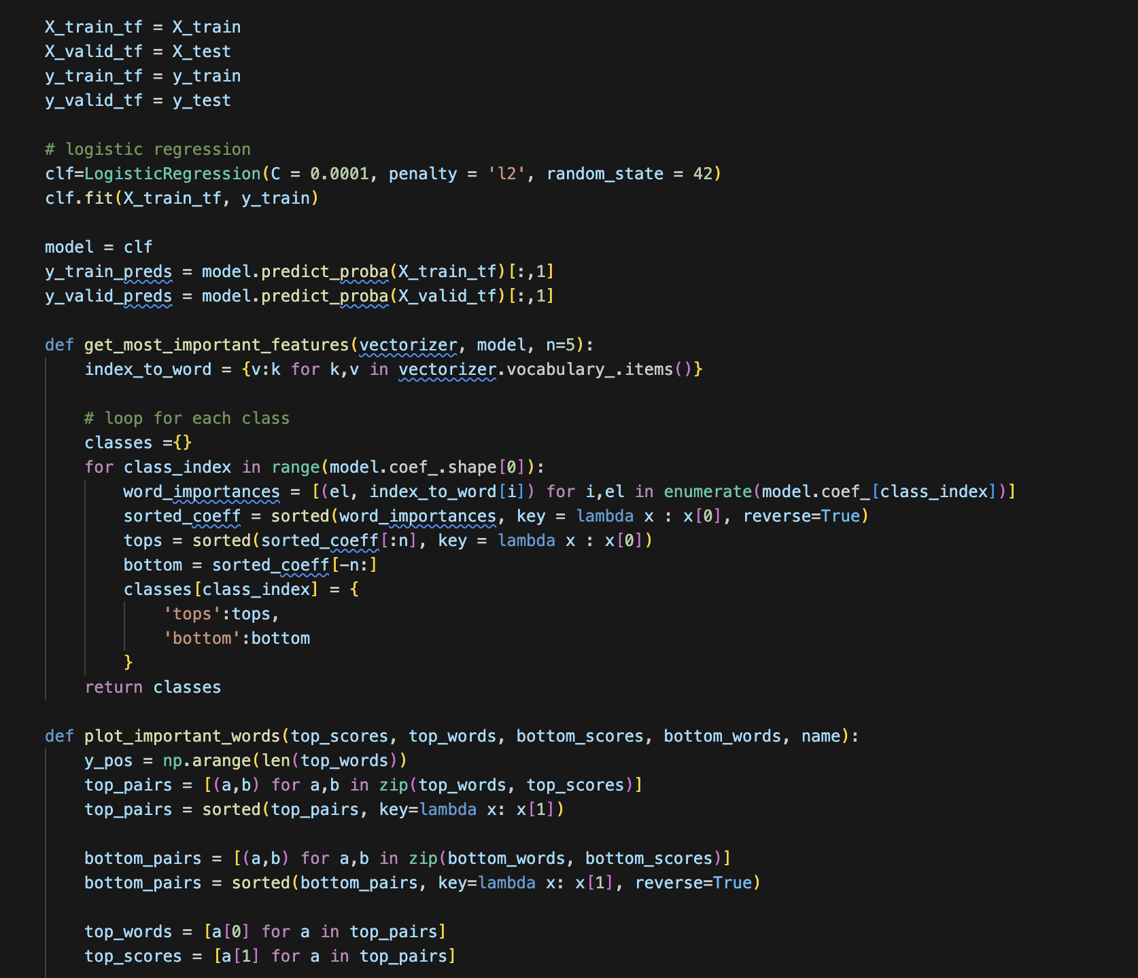
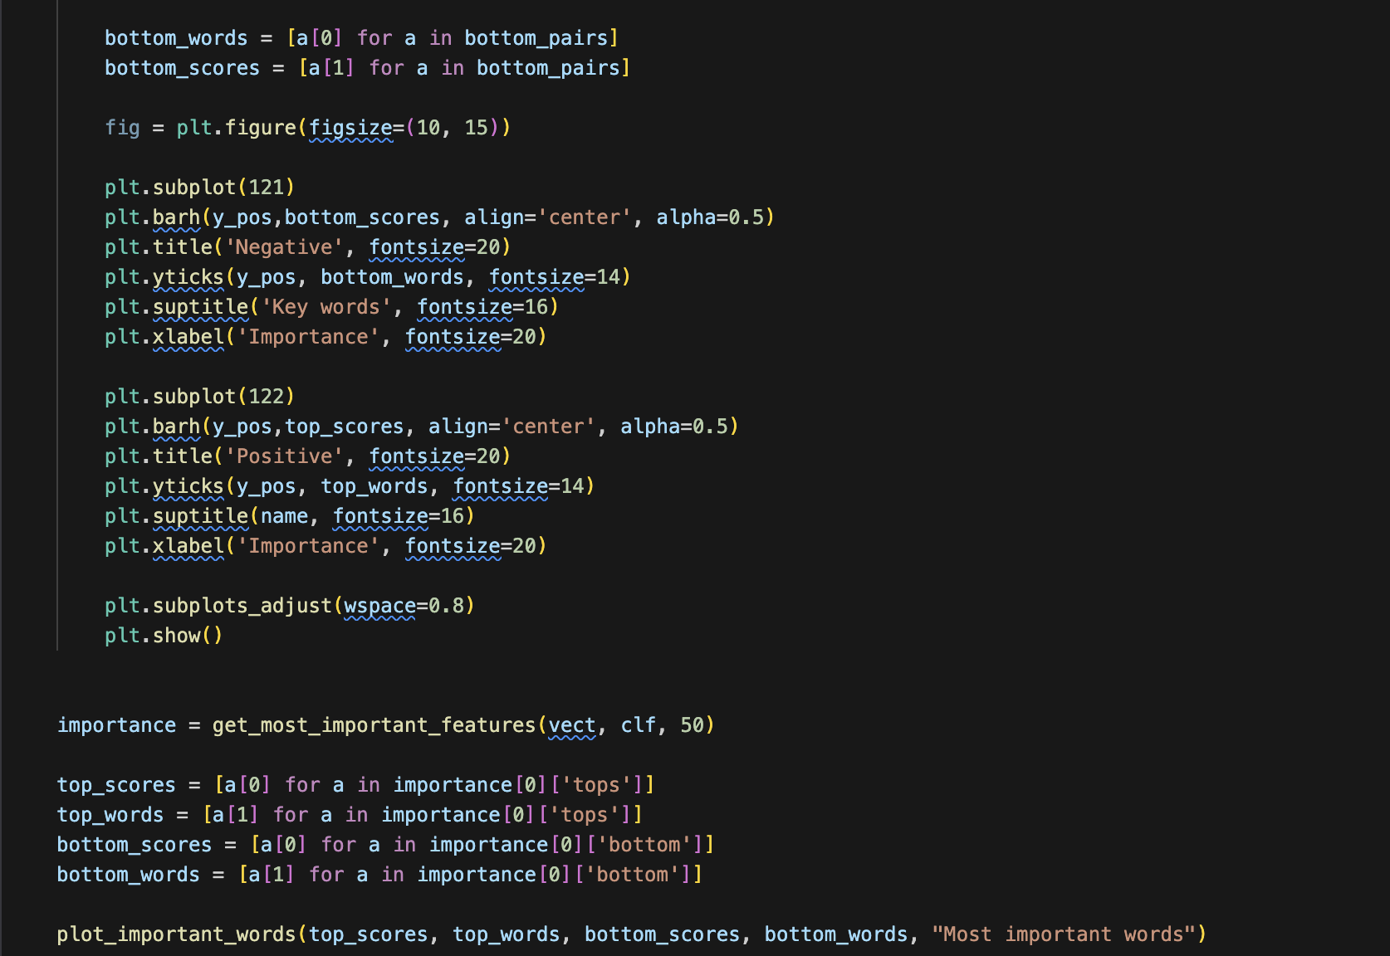
Important Words
Words that matter
Attention weights and frequency counts highlighted high-impact clinical terms.
Words most associated with positive or negative outcomes were identified.
These latent indicators can serve as early warning signals.

Slide 9
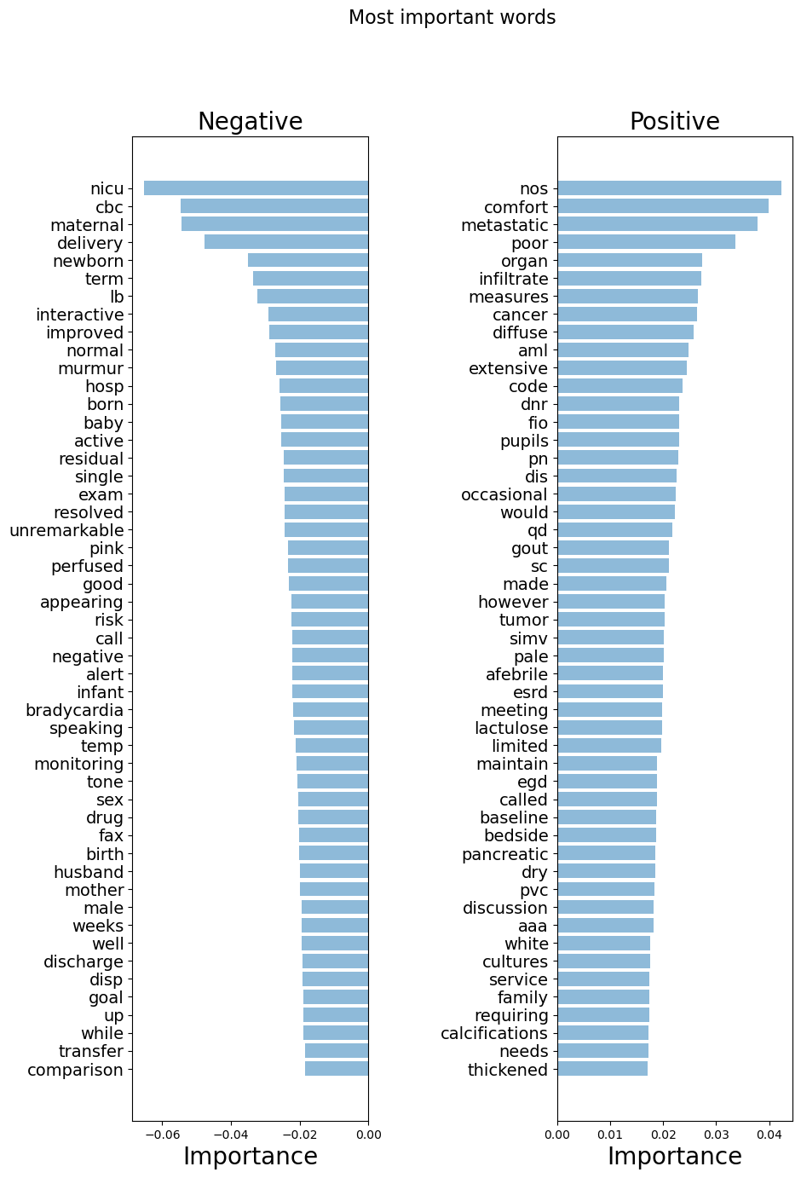
Important Words
Results
Saliency maps visualized which terms drove the model's mortality predictions.
The model highlights the most semantically important words tied to mortality outcomes.
Negative words correspond to patients who survived (expire_flag = 0). Note the appearance of words like ‘good’ and ‘improved’.
Positive words correspond to patients who died (expire_flag = 1). Note the words ‘metastatic’, ‘poor’, and ‘cancer’.

Slide 10
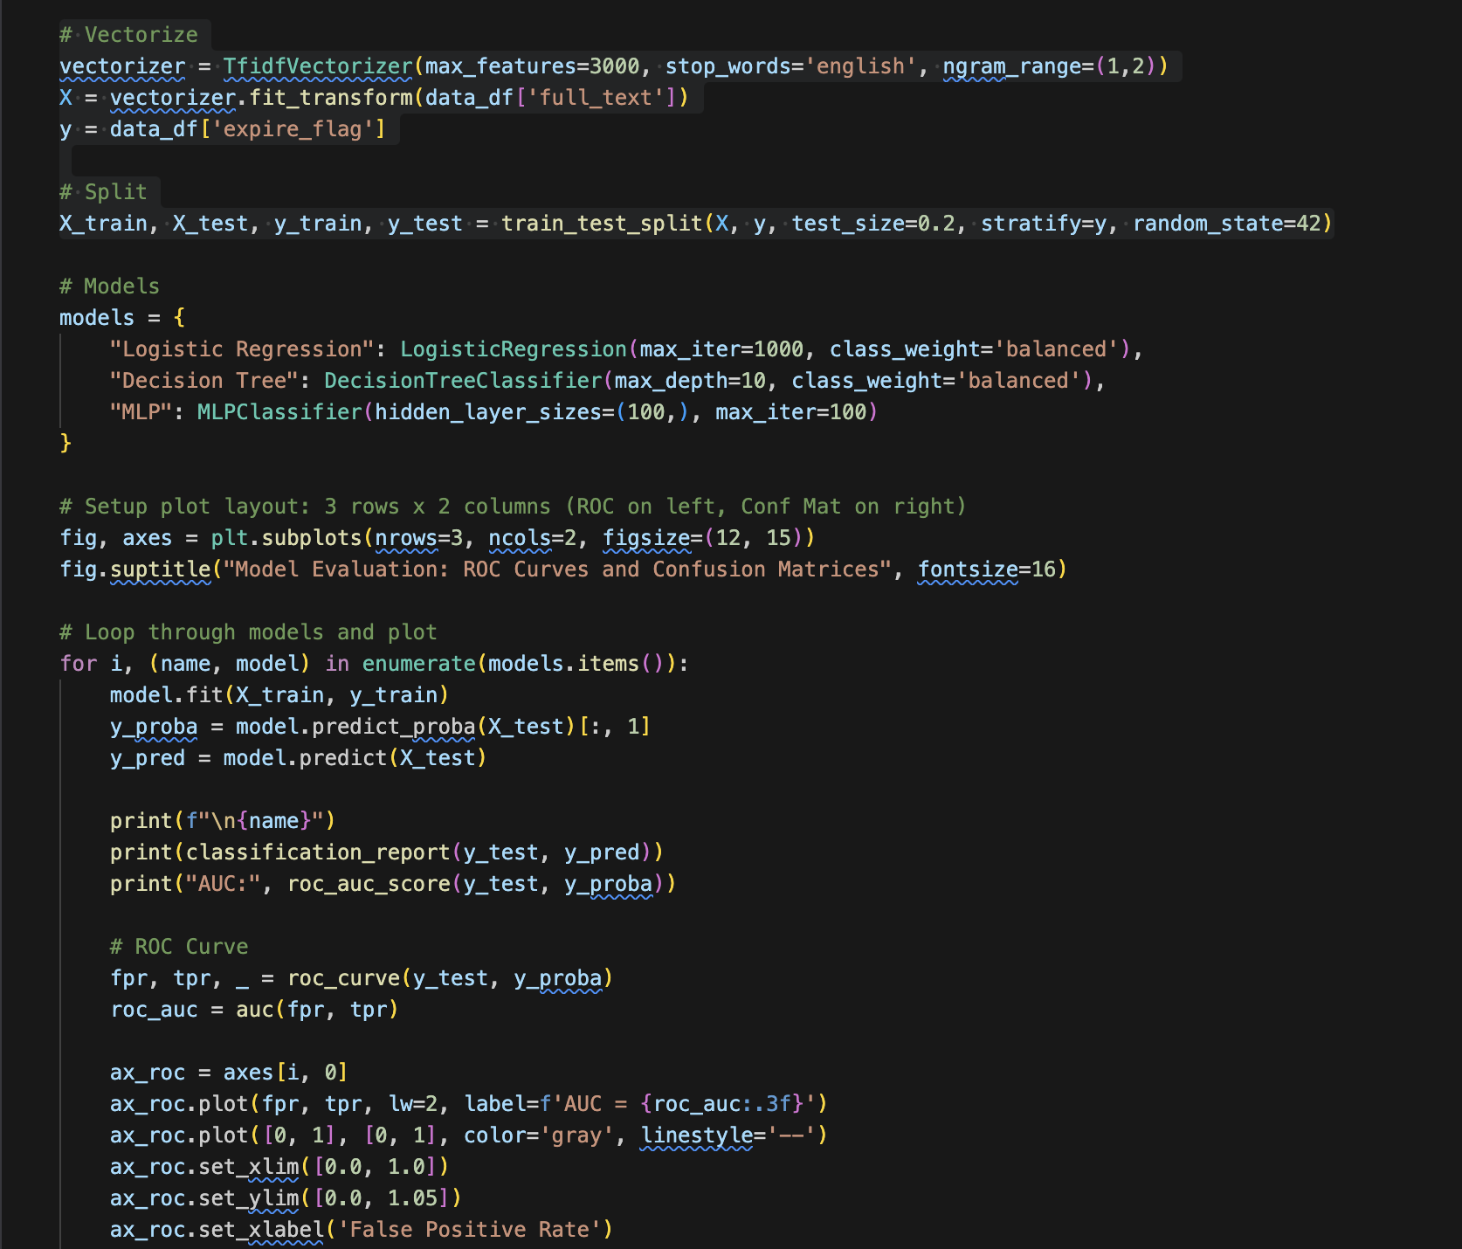
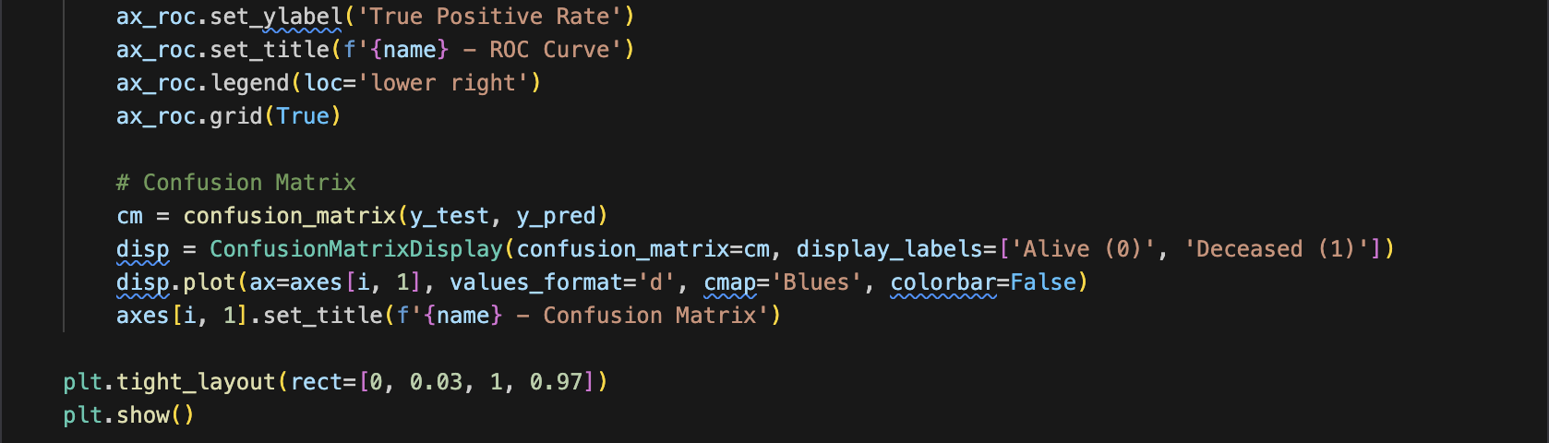
3-Model Comparison
Which model is best?
Three deep learning pipelines were evaluated:
Logistic Regression
Used for binary classification, ideal for mortality prediction.
Decision Tree
Supervised learning method that uses a tree-like structure, used for classification and regression tasks.
Multilayer Perceptron
Neural network, deep learning model that uses input, hidden, and output layers.

Slide 11
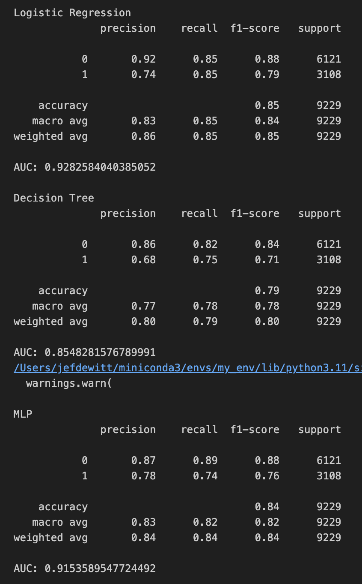
3-Model Comparison
Results
Logistic Regression
Accuracy: 85%, highest among all models
F1-score (class 1): 0.79 – strong balance of precision and recall
AUC: 0.93 – indicates excellent discrimination ability
Class 0 precision: 0.92, recall: 0.85
Decision Tree
Accuracy: 79%, lowest overall
F1-score (class 1): 0.71, struggles more with minority (‘expire_flog’=1) class
AUC: 0.85 – moderate performance
Simpler model but underperforms compared to others
MLP (Multilayer Perceptron)
Accuracy: 84%, close to logistic regression
F1-score (class 1): 0.76, slightly lower recall
AUC: 0.92 – strong performance, nearly matching logistic regression
Better precision for class 1 than Decision Tree

Slide 12
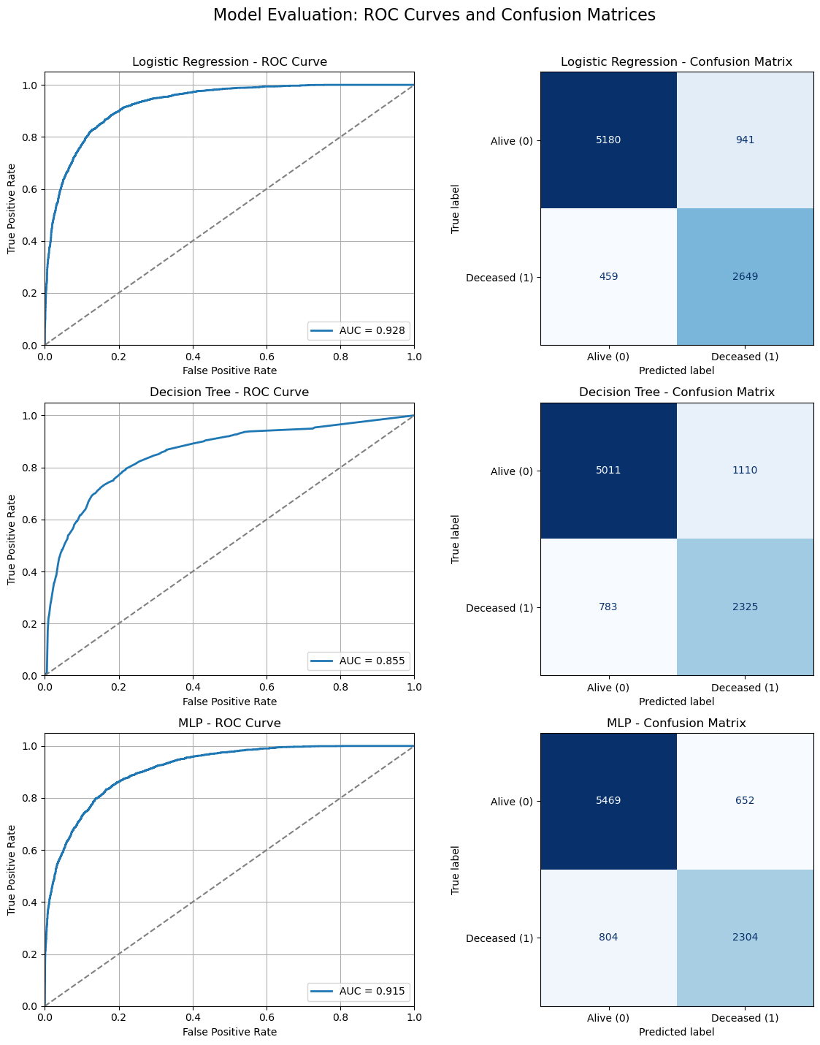
3-Model Comparison
Summary & Takeaways
Logistic Regression best overall: highest AUC, accuracy, and balance.
Curve closely hugs the top-left corner – excellent classification.
Better at capturing minority class (deceased).
Decision Tree interpretable, but underperforms in precision and recall.
Performance degrades quickly as false positive rate increases.
MLP performs second-best, with robust AUC and fewer false positives.
Balances recall and precision well.
Slightly more conservative but fewer misclassifications overall.
Recommendation: Use Logistic Regression or MLP based on interpretability vs complexity trade-off.

Slide 13
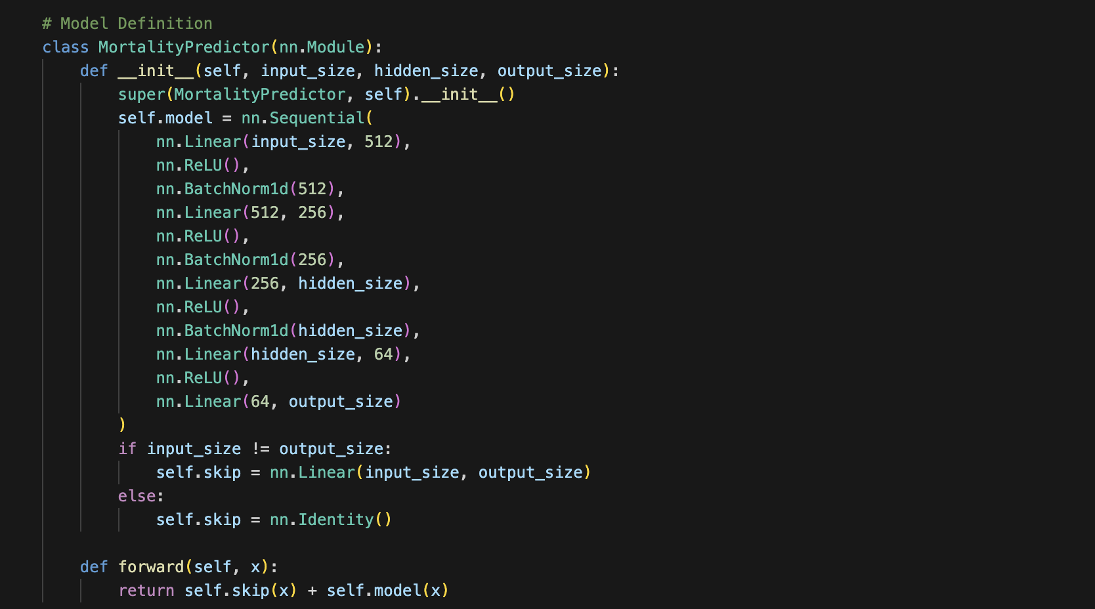
Deeper Learning
Binary Classification with PyTorch
The PyTorch library is used to build deep-learning models.
The custom model definition allows for greater fine-tuning and control.
It is a neural network architecture consisting of a four-layer MLP (multilayer perception).
Residual, or skip, connections allow for better generalization in deeper models.

Slide 14
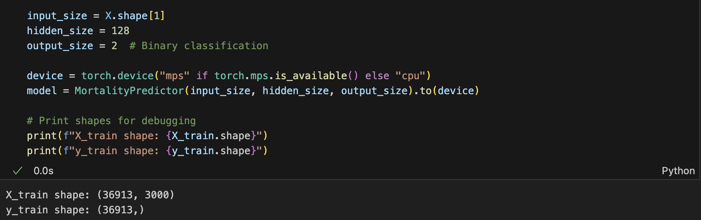
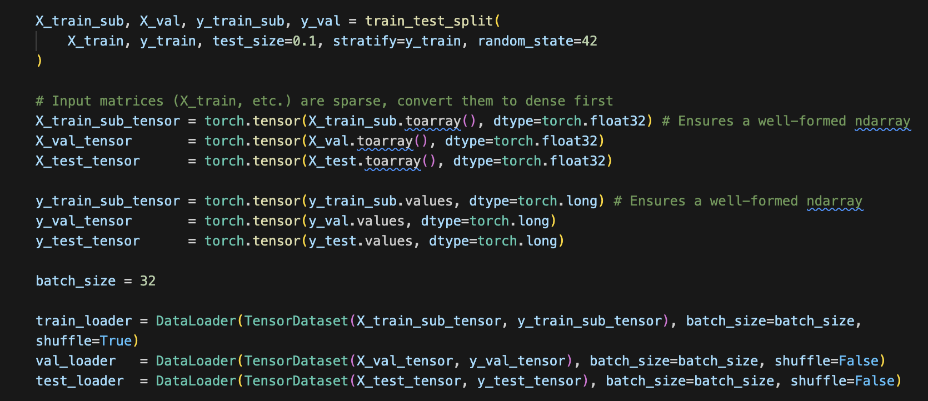
Model Parameters
& Train/Test Splits
Data is split into training (90%) and testing (10%) sets.
3000 features are selected as the input size, hidden layer size is specified at 128 neurons, and output size is 2, representing living and deceased classes of patients.
Data loaders are declared and the model is fed data in batches of 32.
Adam optimization is chosen for classification modeling.
A scheduler reduces the learning rate by 10% after each epoch.
Cross entropy is selected as the loss function.

Slide 15
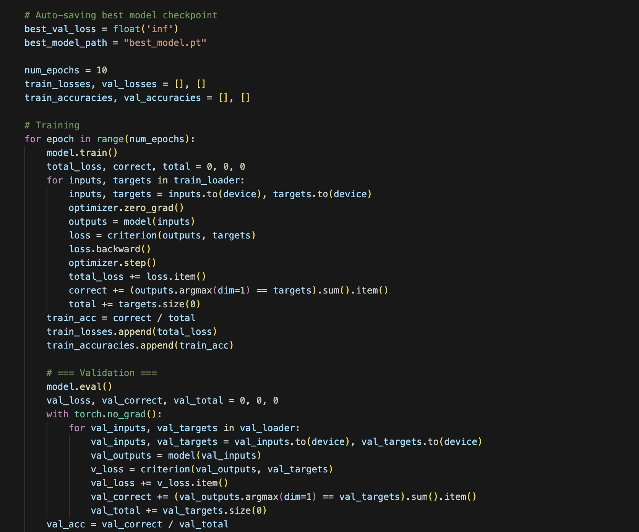
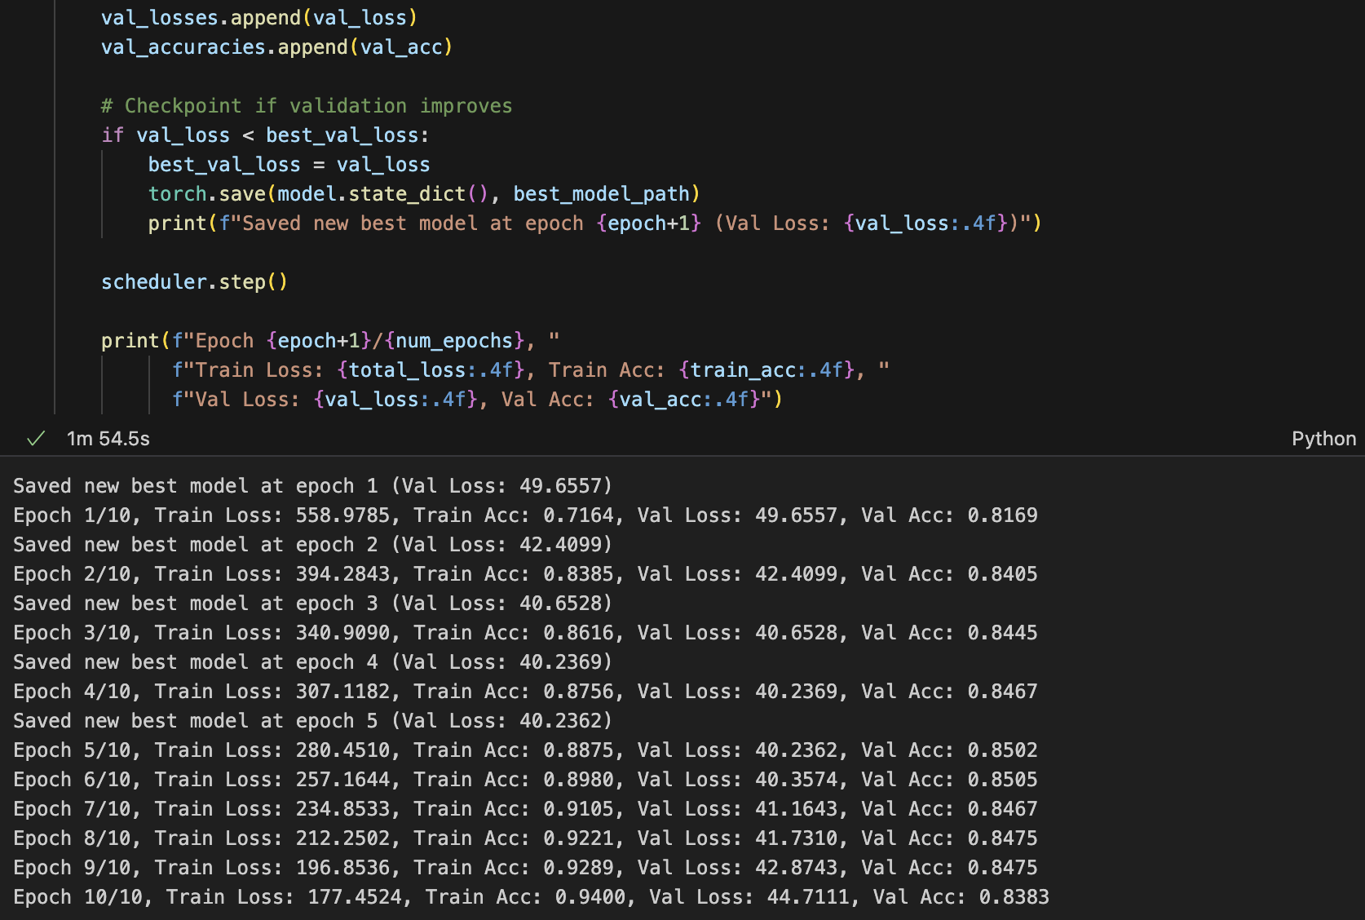
Model Training Process
For Predictive Analysis
The training lasts for a total of ten epochs. Note the epoch with the greatest performance metrics are saved for later.
After each epoch, loss and accuracy are logged, and validation metrics are computed using a held-out test set.
Evaluation mode was enabled via model.eval() to deactivate batchNorm layers.
torch.no_grad() reduced memory usage and sped up inference by skipping gradient tracking.

Slide 16
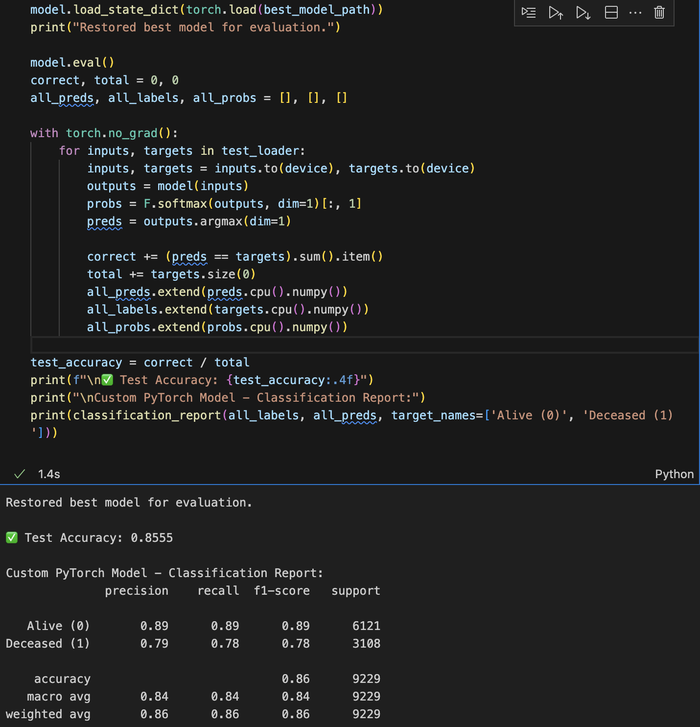
Performance Evaluation
Accuracy Scores
Overall accuracy score of 86%.
F1 scores are a more balanced metric, especially useful for class imbalances.
The data skewed 2-1 in favor of surviving patients, which may explain the higher F1 scores (89%) relative to deceased patients (78%).

Slide 17
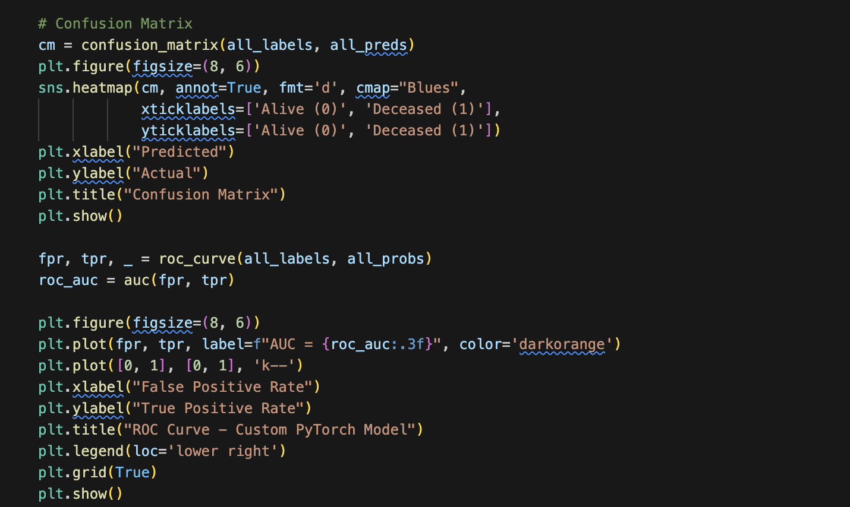
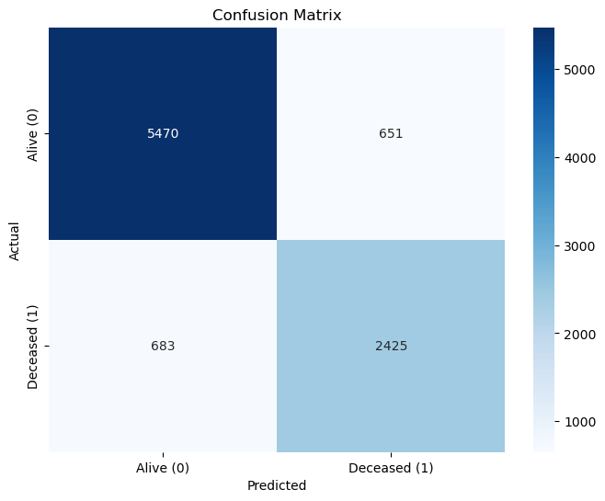
Confusion Matrix
Performance Visualization
The confusion matrix is a visual summary.
Top-left: true positives (correctly predicting patients that did not die in-hospital).
Top-right: false positives (predicting survival of deceased patients).
Bottom-left: false negatives (incorrectly predicting in-hospital patient deaths).
Bottom-right: true negative (correctly predicting in-hospital deaths).

Slide 18
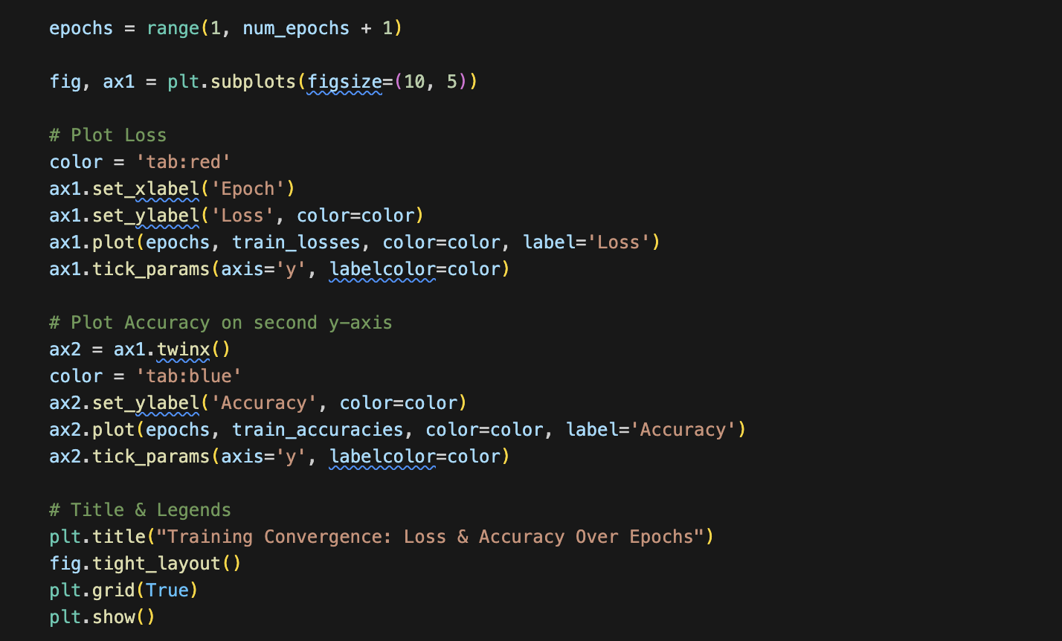
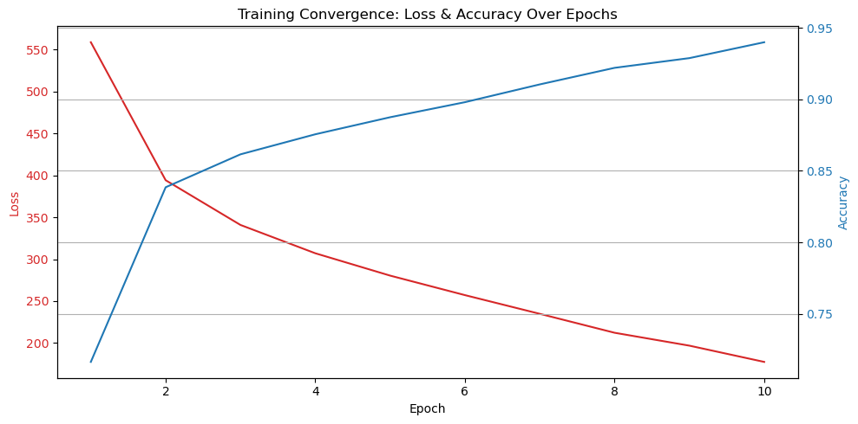
Training Convergence
Loss & Accuracy
The training set is used during model “learning”.
Training loss dropped quickly, indicating rapid model fit to the training set.
This points to overfitting, where the model begins memorizing training data, reducing its ability to generalize to new data.

Slide 19
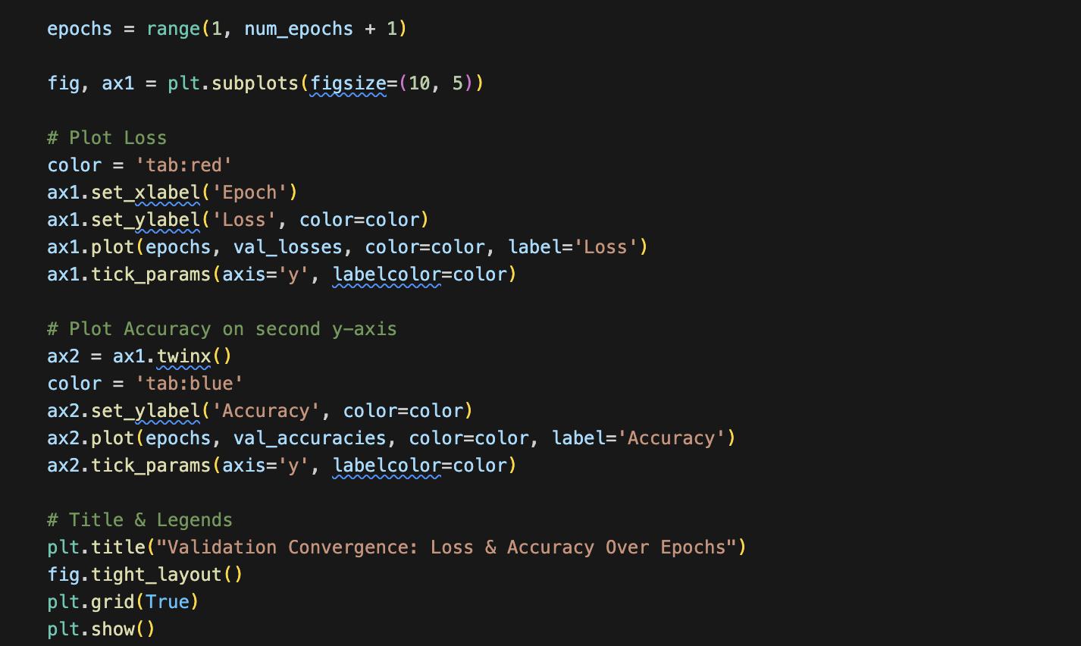
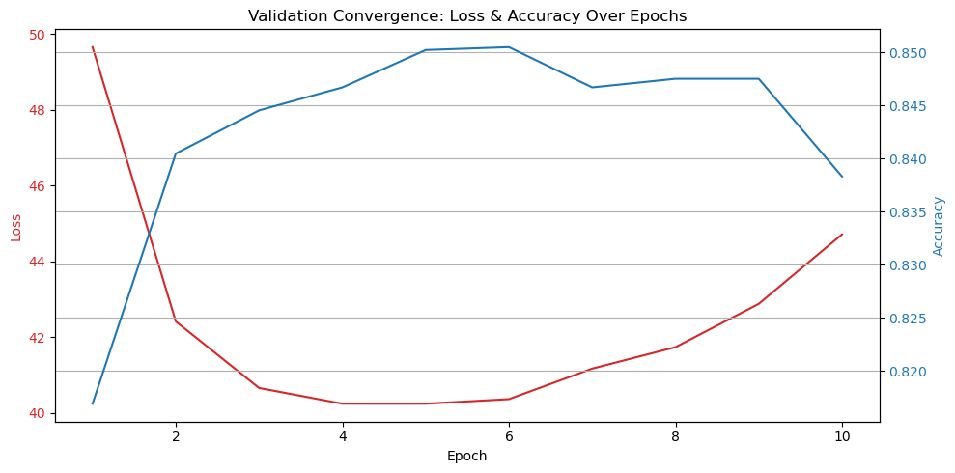
Validation Convergence
Loss & Accuracy
The validation set is used during model evaluation. It has already been trained and is now inferring on its own.
Validation accuracy improved gradually but remained lower than training accuracy.
Note peak performance occurs at epoch 6, where a snapshot of model weights and training state is preserved.
A saved training session state solved the problem of overfitting by preserving optimum model weights and training state (epoch 6).

Slide 20
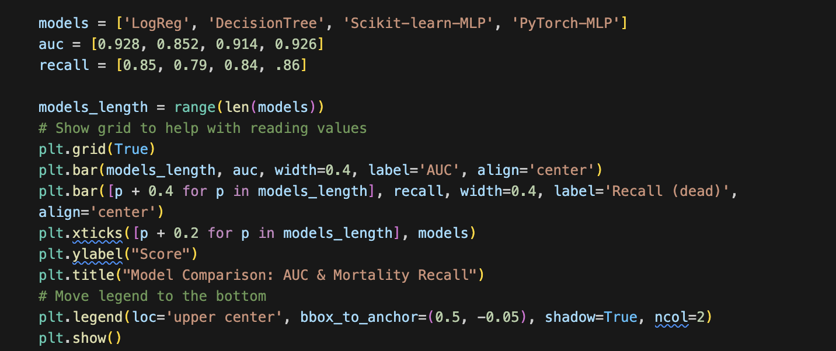
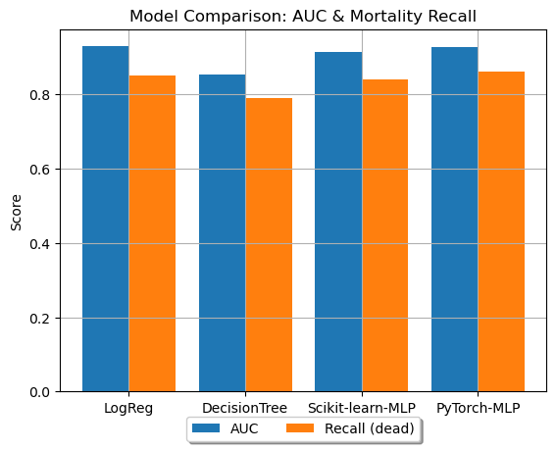
4-Model Comparison
Summary & Takeaways
Comparing four models: Logistic Regression, Decision Tree, Scikit-learn MLP, and PyTorch MLP.
PyTorch MLP offers the best balance, while Logistic Regression is a strong competitor with high performance and interpretability.
Model choice depends on the priority: overall accuracy (AUC) vs. sensitivity to critical cases (recall).
Recommendation: Use PyTorch MLP based on both performance and customization options.

Slide 21
Findings
The study confirms that unstructured notes hold valuable signals. However, mortality prediction remains challenging. Current models show modest accuracy but struggle with minority-class generalization. Overfitting and signal dilution remain problematic.
Ultimately, early mortality risk detection could enable proactive interventions and save lives. This work provides a strong foundation for deeper exploration of clinical NLP and Deep Learning.

Slide 22
Future Work
Additional models, such as transformers, could improve semantic capture in notes. Incorporating lab results, vitals, and other patient data could enhance prediction accuracy. Training on multi-institutional datasets could also improve model generalizability.
Future work should prioritize clinician feedback and hospital integration for impact.

